Slide 1
Chapter 5
Chapters
1. Introduction
2. Graphs
3. Descriptive statistics
4. Basic probability
5. Discrete distributions
6. Continuous distributions
7. Central limit theorem
8. Estimation
9. Hypothesis testing
10. Two-sample tests
13. Linear regression
14. Multivariate regression
Random Variables and Discrete Probability Distributions

Slide 2
Random Variables (RV)
When the value that a variable assumes at the end of an experiment is the result of a chance or random occurrence, that variable is a Random Variable (R.V.)
Discrete Random Variable
– takes on finite or infinite but a countable number of different values
– E.g. values on the roll of dice: 2, 3, 4, …, 12
– “gaps” between values along the number line
– possible to list all results and the associated probabilities
Continuous Random Variable
– takes on any value in an interval.
– E.g. time (30.1 minutes? 30.10000001 minutes?)
– no “gaps” between values along the number line
– cannot associate possibility with a single value, only a range of values.
Analogy: Integers are Discrete, while Real Numbers are Continuous

Slide 3
Probability Distributions…
A probability distribution is a table, formula, or graph that describes the values of a random variable and the probability associated with these values.
Since we’re describing a random variable (which can be discrete or continuous) we have two types of probability distributions:
– Discrete Probability Distribution
– Continuous Probability Distribution

Slide 4
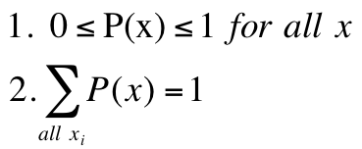
Probability Notation…
An upper-case letter will represent the name of the random variable, usually X.
Its lower-case counterpart will represent the value of the random variable.
The probability that the random variable X will equal x is:
P(X = x) or more simply P(x)

Slide 5
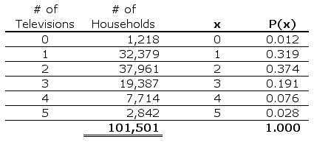
Example 5.1…
Probability distributions can be estimated from relative frequencies.
Consider the discrete (countable) number of televisions per household from US survey data. E.g. what is the probability there is at least one television but no more than three in any given household?
1,218÷101,501=0.012
“at least one television but no more than three”
P(1 ≤ X ≤ 3) = P(1) + P(2) + P(3) = .319 + .374 + .191 = .884
e.g. P(X=4) = P(4) = 0.076 = 7.6%

Slide 6
Population/Probability Distribution…
The discrete probability distribution represents a population
Example 5.1 the population of number of TVs per household
Since we have populations, we can describe them by computing various parameters.
E.g. the population mean and population variance.

Slide 7

Population Mean (Expected Value)
The population mean is the weighted average of all of its values.
The weights are the probabilities.
This parameter is also called the expected value of X and is represented by E(X).

Slide 8



Population Variance…
The population variance is calculated similarly. It is the weighted average of the squared deviations from the mean.
As before, there is a “short-cut” formulation…
The standard deviation is the same as before:

Slide 9

Example 5.1
Find the mean, variance, and standard deviation for the population of the number of color televisions per household… (from Example 7.1)
= 0(.012) + 1(.319) + 2(.374) + 3(.191) + 4(.076) + 5(.028)
= 2.084

Slide 10

Example 5.1
Find the mean, variance, and standard deviation for the population of the number of color televisions per household… (from Example 7.1)
= (0 – 2.084)²(.012) + (1 – 2.084)²(.319)+…+(5 – 2.084)²(.028)
= 1.107

Slide 11
Laws of Expected Value…
E(c) = c The expected value of a constant (c) is just the value of the constant.
E(X + c) = E(X) + c
E(cX) = cE(X) We can “pull” a constant out of the expected value expression (either as part of a sum with a random variable X or as a coefficient of random variable X).

Slide 12
Example 5.2
Monthly sales have a mean of $25,000 and a standard deviation of $4,000.
Profits are calculated by multiplying sales by 30% and subtracting fixed costs of $6,000.
Find the mean monthly profit.
sales have a mean of $25,000 ➔ E(Sales) = 25,000
profits are calculated by… ➔ Profit = .30(Sales) – 6,000
E(Profit) =E[.30(Sales) – 6,000]
=E[.30(Sales)] – 6,000 [by rule #2]
=.30E(Sales) – 6,000 [by rule #3]
=.30(25,000) – 6,000 = 1,500
Thus, the mean monthly profit is $1,500

Slide 13
Laws of Variance…
V(c) = 0 The variance of a constant (c) is zero.
V(X + c) = V(X) The variance of a random variable and a constant is just the variance of the random variable (per 1 above).
V(cX) = c²V(X) The variance of a random variable and a constant coefficient is the coefficient squared times the variance of the random variable.

Slide 14
Example 5.2
Monthly sales have a mean of $25,000 and a standard deviation of $4,000.
Profits are calculated by multiplying sales by 30% and subtracting fixed costs of $6,000.
Find the standard deviation of monthly profits.
The variance of profit is = V(Profit)
=V[.30(Sales) – 6,000]
=V[.30(Sales)] [by rule #2]
=(.30)²V(Sales) [by rule #3]
=(.30)²(16,000,000) = 1,440,000
Again, standard deviation is the square root of variance, so standard deviation of Sdev(Profit) = (1,440,000)^{1/2} = $1,200

Slide 15
Optional

Slide 16
Bivariate Distributions…
Up to now, we have looked at univariate distributions, i.e. probability distributions in one variable.
As you might guess, bivariate distributions are probabilities of combinations of two variables.
Bivariate probability distributions are also called joint probability.
A joint probability distribution of X and Y is a table or formula that lists the joint probabilities for all pairs of values x and y, and is denoted P(x,y).
P(x,y) = P(X=x and Y=y)

Slide 17
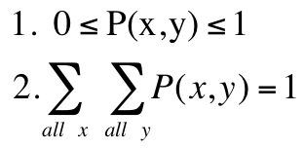
Discrete Bivariate Distribution…
As you might expect, the requirements for a bivariate distribution are similar to a univariate distribution, with only minor changes to the notation:
for all pairs (x,y).

Slide 18
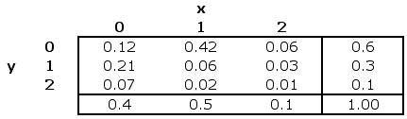
Example 7.5…
Xavier and Yvette are real estate agents; let’s use X and Y to denote the number of houses each sells in a month. The following joint probabilities are based on past sales performance:
We interpret these joint probabilities as before.
E.g the probability that Xavier sells 0 houses and Yvette sells 1 house in the month is P(0, 1) = .21

Slide 19


Marginal Probabilities…
As before, we can calculate the marginal probabilities by summing across rows and down columns to determine the probabilities of X and Y individually:
E.g the probability that Xavier sells 1 house = P(X=1) =0.50

Slide 20
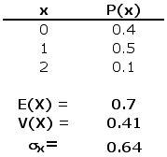
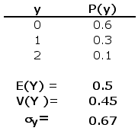
Describing the Bivariate Distribution…
We can describe the mean, variance, and standard deviation of each variable in a bivariate distribution by working with the marginal probabilities…
same formulae as for univariate distributions…

Slide 21


Covariance…
The covariance of two discrete variables is defined as:
or alternatively using this shortcut method:

Slide 22

Coefficient of Correlation…
The coefficient of correlation is calculated in the same way as described earlier…

Slide 23
Example 5.3
Compute the covariance and the coefficient of correlation between the numbers of houses sold by Xavier and Yvette.
COV(X,Y) = (0 – .7)(0 – .5)(.12) + (1 – .7)(0 – .5)(.42) + …
… + (2 – .7)(2 – .5)(.01) = –.15
= –0.15 ÷ [(.64)(.67)] = –0.35
There is a weak, negative relationship between the two variables.

Slide 24
Laws…
We can derive laws of expected value and variance for the linear combination of two variables as follows:
E(aX + bY) = aE(X) + bE(Y)
V(aX + bY) = a²V(X) + b²V(Y) + 2abCOV(X, Y)
If X and Y are independent:
COV(X, Y) = 0
and thus:
V(aX + bY) = a²V(X) + b²V(Y)

Slide 25
Example 5.3
Suppose the profit for Xavier is $2,000 per house sold, and that for Yvette is $3,000.
What is the expected value and variance for the total profit of Xavier and Yvette?
Linear combination: TP=2000X+3000Y
E(TP)=2000E(X)+3000E(Y)=2000*.7+3000*.5=2900 V(TP)=2000²V(X)+3000²V(Y)+2*2000*3000*COV(X,Y)
=2000²*0.41+3000²*0.45+2*2000*3000*(-.15)
=1640000+4050000-1800000
=3.890,000

